Slide 1

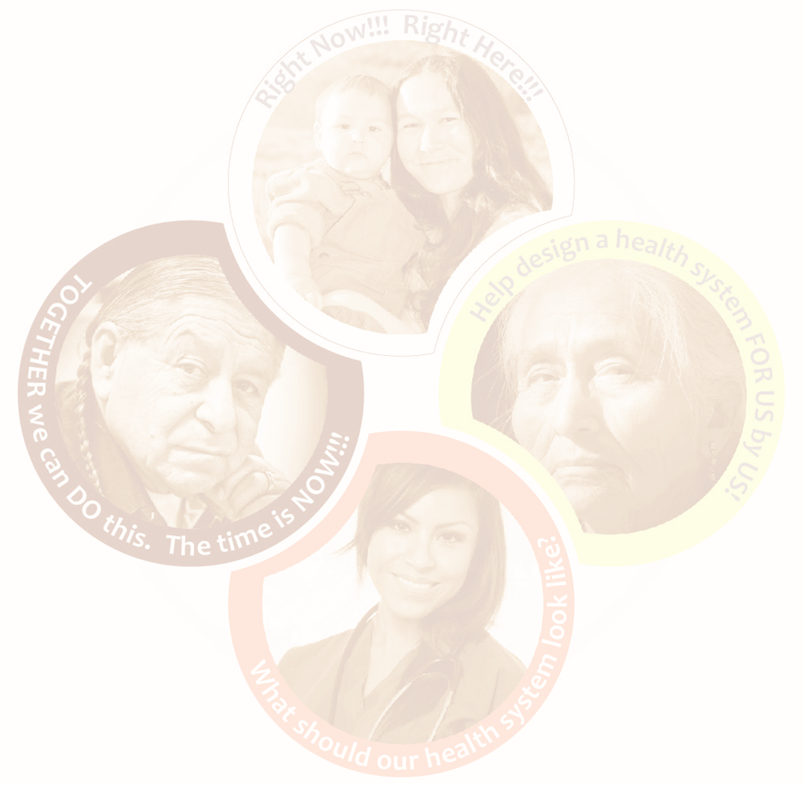
Project Overview
Presentation

Slide 2

Concept
Many First Nations have been advocating for greater control over their health and wellness, consistent with the inherent right to self-determination

Slide 3
Goal
Anishinabek Nation’s goal is to aid their member First Nations in building a system that belongs to them.
Designed & Delivered by Anishinabek
Holistic
Community Driven
Culturally Relevant
Responsive to our needs

Slide 4

What Anishinabek Nation Health Transformation may look like, and mean for communities:
Investigating First Nation health needs and responding appropriately.
A system reflective of Anishinabe values and teachings.
39 First Nations strongly advocating together for improved services and increased, sustainable funding.
The ability to govern and have control over health service delivery with the necessary funding from governments.
A grassroots model working for the 39 First Nations, one which is truly community-driven and respects community autonomy in decision making.
A fully-fledged health authority with a central administrative body coupled with service delivery at the community level.
Flexibility in decision making around funding, in order to more appropriately deploy resources based on identified needs, not population-based formulas or proposal-based funding.

Slide 5
Background Overview
June 2016 - The Anishinabek Nation Chiefs in Assembly passed a resolution directing the Health Secretariat to begin engagement with levels of government on First Nation’s control of health
November 2016 – Model exploration, the Chiefs Committee on Health began meeting with the First Nations Health Authority in British Columbia

Slide 6
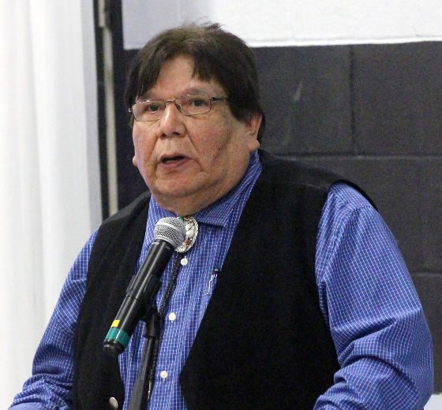
Background Overview
Spring 2017 - Grand Chief Madahbee & Chief Tom Bressette met with federal and provincial representatives to discuss Health Transformation and a Memo of Understanding (MOU).
Spring 2018 – a MOU developed and signed resulting from tripartite meetings
December 2018 - Health Directors Summit

Slide 7
Background Overview
In 2019:
Directors Summit feedback gathered
Health Authority models reviewed (BCFNHA, Sioux Lookout, NAN)
June - updated resolution passed to continue the Health Transformation process
Technical working group formed, TOR developed & approved
Community engagements initiated

Slide 8
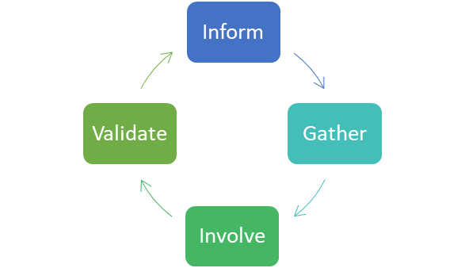
Engagement
The Engagement process aims to partner with communities along the transformation journey by:
Informing you of the plan to conduct various activities to ensure participation in the change
Gathering your feedback on draft plans and recommendations, in order to understand your concerns and aspirations
Involving communities in the planning and
design of the Health System to ensure their
ideas and concerns are reflected in alternatives and recommendations
Validating what we’ve heard from listening
to our leadership, management, front line
workers, and citizens

Slide 9
Past Engagement Questions
Engagement questions to community management and front line workers included:
What are the current challenges to having our own health system?
What are the gaps in our current health services?
How can Health systems and health delivery be enhanced?
What potential changes are needed regarding relationships and governance for our own health system to work?

Slide 10

Community Response
Respects and reflects traditional approaches to healing, our medicines, and cultural values
Treats the whole person, not just the illness
Collective effort and collaboration while respecting individual First Nations Autonomy;
Meets community needs, as close to home as possible

Slide 11
Community Response
Values
Principles
Inclusiveness, community voice
Cultural sensitivity
Land based healing and programming
7 Grandfather teachings, emphasizing equality and fairness
Medicine Wheel Teachings, including the concept of holistic health
Addressing community needs, especially children and youth
Fairness, Flexibility
Accountability –individual and organizational
Action based – continuity in moving forward
Community based decision making
Transparency, clearly defined goals
Sustainability
Safe, quality, trauma informed care
Continuous quality assurance

Slide 12
Actions Taken
2020
Tripartite meetings held
Working group formation initiated
Assessment needs and Environmental scan surveys developed
PTO & FN community engagement for Best Practices
Website domain purchased and development initiated
Grand Council Resolution acquired
Project Staff recruitment initiated

Slide 13
Actions Taken
2021
Tripartite meetings
Working group formation initiated
Website design and uploading
Project Staff recruitment – Communications Officer, Engagement & Working Group Coordinator , Negotiator
Advertisements - promotion, engagement and call outs

Slide 14
Goals
Short Term 0 – 3 mths
Continue Recruitment efforts
Engagement & Working Group Coordinator
Negotiator RFP
Continue Working Group Formation
Initiate Working Group Meetings
Training and Development

Slide 15
Goals
Short Term cont’d..
Communications –website, social media, correspondence (advertising, promotion, call outs, information)
Develop HT structure
Develop engagement plan
Initiate engagement sessions
Data collection, analysis, & evaluation

Slide 16
Goals
Intermediate 3 - 6 mths
Recruitment
Continue Engagement Sessions & Working Group Meetings
Regional Engagement Officers
RFP’s – Research Lead, Health Professional Consultant, Traditional Medicine & Knowledge Keepers, Translation.
Research Health models and systems
Draft Strategic Approaches & Framework Agreement developed

Slide 17
Goals
Intermediate 3 - 6 mths
BCR’s (distribution and collection)
Committee formation – Finance, Communication Subs, Management, Implementation
Environmental Scan & Needs Assessment distribution and collection
Analysis
Draft Health Models

Slide 18
Goals
Medium to Long Term 6mths – 1Yr+
Incorporate Laws
Fiscal negotiations
Validate
Legislative Review
Law Development
Health Authority/ Commission (AFNHA)
Validate

Slide 19
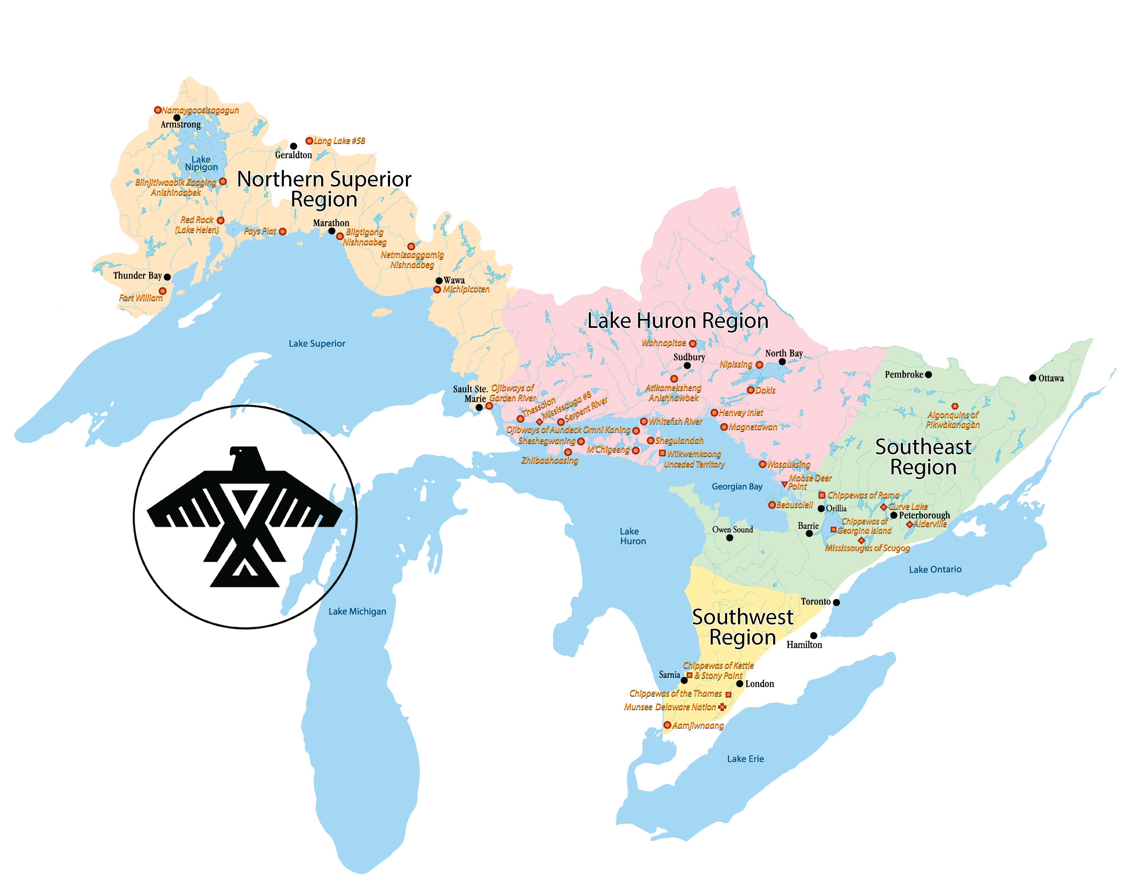
Challenges
Present & Anticipated:
Funding
Human Resources for project
Expansive territory
Extensive engagements
Covid:
  Outreach and response;
  Formation of working relationships;
  Building rapport;
  Virtual technology and connectivity;
  Travel limitations
  Turn around time

Slide 20
Contact Information
Jess Pamajewon
Health Transformation Administrative Coordinator
Jessica.pamajewon@anishinabek.ca
705-497-9127 x2231
Loretta Nootchtai
Health Transformation Project Manager
Loretta.Nootchtai@anishinabek.ca
705-497-9127
Jamie Restoule
Health Director
Jamie.restoule@anishinabek.ca
705-497-9127 x2242

