Slide 1
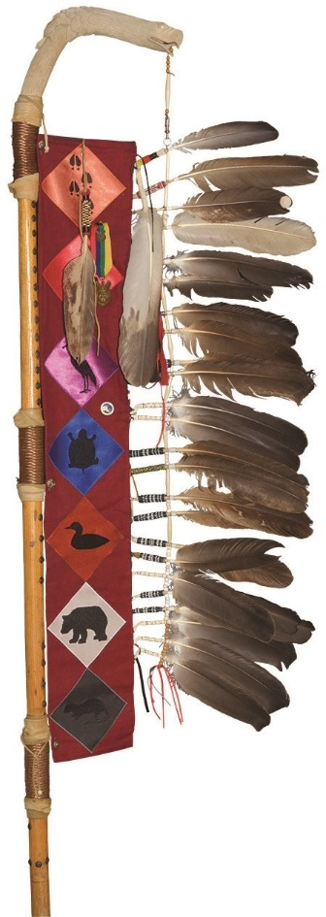
Summary of the Anishinabek Nation
Socio-Demographic Study
Presentation by
Leanna Farr, Anishinabek Nation Legal Counsel
Anishinabek Nation
E’Dbendaagzijig (Citizenship) Virtual Conference
February 1, 2022

Slide 2
Background Info – What was the study about?
Anishinabek Socio-demographic study, 2017
Prologica Research & Four Directions Project Consultants & UOI
Data from
  Census of Canada
  Department of Indian and Northern Affairs Indian Register
Data about Age, Gender, Aboriginal Identity, Language Knowledge, Education, Employment, Occupations, Industries, Income

Slide 3
Language – Anishinaabemowin
Only 4% use Ojibway as primary language in the home
Most used in Lake Huron region (17% mother tongue; 7% most frequent language used at home)
Highest in Wiikwemkoong Unceded Territory

Slide 4
Population
2002 – 2016 most growth of Registered Indian population occurred off-reserve; On-reserve only modest growth
Registered Indian Population living on-reserve continued to decline 2002 – 2016 and trend for long-term
Anishinabek Nation Region | % Growth Registered Indian Population – On-Reserve (2002 – 2016) | % Growth Registered Indian Population – Off-Reserve (2002 – 2016)
Southwest | 14% | 41%
Southeast | 15% | 51%
Lake Huron | 15% | 39%
Northern Superior | 19% | 36%

Slide 5
Population Cont’d
Population growth/declines can result from the following:
  Demographic factors (i.e. natural increase via births – deaths)
  Migration (ex. on-reserve -> off-reserve)
  Legislation changes
2010 – 2016 Registered Indian population growths due to legislative amendments (Indian Act Bill C-3)
Most additions from 2010 – 2016 off-reserve
  77 additions on-reserve
  5,763 additions off-reserve

Slide 6
Indian Act Registration & Populations
Parenting between Registered Indian and non-Registered individuals (exogamous parenting)
Bill C-3 2010 Indian Act amendments and Bill S-3 2017 amendments will cause initial rise
Estimated total 4,966 additions, majority being additions off-reserve
Indian Act will impact populations of Anishinabek First Nations in future (Registered versus non-Registered)
Registered Indian population projected to rise for about 20 yrs before declining
Non-entitled descendants projected to grow rapidly (increase of 230%)

Slide 7
Age Structure
Pronounced shifts in Registered Indian populations
2002 – 2016 declining concentrations of children (0-14 yrs)
Rise in older populations; particularly older adults (45-64 yrs) and seniors (65 + yrs)
Projected on-reserve growth to slow & shift in age structure of seniors (65+ yrs) to double
Aging on-reserve populations projected
Off-reserve is even more pronounced

Slide 8
Labour Force
Labour force is 15yrs – 65+ yrs
Registered on-reserve Labour Force expected to grow; however, at slower rates than in past and then decline at the end of 2041
Registered off-reserve Labour Force expected to slow dramatically & eventually decline by 2041
Declines in Labour Force growth = Dependency rates increase
Child dependents projected to decline
Elderly dependents projected to increase

Slide 9
Educational Attainment
47% residents of Anishinabek First Nations have post-secondary diploma, degree or certificate (inc. Trades, Apprenticeship, College or University)
22% have High School certificate or equivalent
AN FN averages are lower than Ontario averages
Higher rates of College/Trades/Apprenticeships versus University Degrees
Higher rates of men (34%) than women (28%) with no certification
Many AN have continued to pursue education as they age
Some types of certification have doubled (ex. University and College)

Slide 10
Employment
2016 AN Labour Force participation rate 53%
Was 8 points lower than the Ontario average (65%)
AN Employment Rate (44%) 16 points lower than Ontario average (60%)
Unemployment rate in AN FNs (18%) is more than double the Ontario average (7%)
Highest employment in the South regions and lowest Northern Superior and Lake Huron regions
Full and part-time and gender not huge discrepancies
Self-employment in AN FNs (5%) less than Ontario (12%)

Slide 11
Income
1995 – 2015 census data income & income sources in AN FNs
Average individual income (adjusted for inflation) up 21% from $22,545 in 1995 to $27,327 in 2015
Ontario averages are higher but increase rate similar $39,192 in 1995 and $47,915 in 2015
Average AN incomes range $27,000 - $25,000 (lower in Southwest)
Ontario north average income range $43,600
Ontario South average income range $48,000

Slide 12
Income
2015 AN most (both men & women) income from Employment
Government Transfer Payments more income source for women than men
Other Sources (pension & investments) lowest income source
Ontario income from Employment sources much higher than Government Transfer Payments or Other Sources
AN Household Income in 2015 was $50,689 versus Ontario $97,865 (AN 52% of Ontario average)

Slide 13
Marital and Family Status
Less AN (40%) formally married than Ontario families (71%)
AN common law 25% versus Ontario 12%
AN single parent families 25% double compared to Ontario 17%
Most single parent families are females (26%) versus males (9%)
AN lone parent families increased from 27% in 1996 to 36% in 2016 – More than 1 in 3 lone parent families (also increase in Ontario, but smaller)

Slide 14
Housing
AN has higher rates of
  housing condition deficiencies 4.4 x higher
  Over-crowding 1.2 x higher
  Shared family dwelling 1.2 x higher
No improvements of “physical conditions of the housing stock on-reserve in past two decades from 1996 – 2016
Estimated 45% increase of # of Registered Indian households on-reserve over next 25 yrs (most in SW and NS regions) and same for off-reserve
Non-family households on-reserve to increase 77% over 2016; more than family households
Due to aging population growth

Slide 15
Helpful info for focus of Policy & Supports
Language - Anishinaabemowin
Citizenship – E’Dbendaagzijig
Aging Population
Education
Employment
Income
Housing
Families

Slide 16
Miigwetch!
Questions or Comments

