Slide 1
Citizenship through the lens of Adoption
Anishinabek Nation Dr. Damien Lee
Citizenship Conference II Yellowhead Institute
April 28, 2022 X University

Slide 2
Who I am
Adopted into Fort William First Nation (MacLaurin)
Adopted through Anishinaabe law, not provincial law
Member of Fort William FN

Slide 3
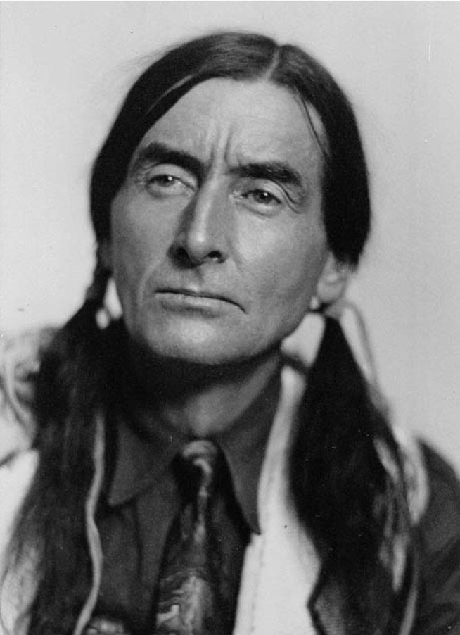
What this is not…
Not a review of E’Dbendaazijig Naaknigewin
Not a review of any First Nation’s existing membership code
Not a “how to” manual for white people to invade Anishinaabe communities
Rather... A discussion about how adoption might inform Anishinaabe citizenship law
Source: Library and Archives Canada
/MIKAN 3623343

Slide 4
Outline
Why citizenship?
Why adoption?
Two stories
Locating kinship-citizenship principles
Wrap up

Slide 5
Why citizenship?
Anishinaabe nations = nations
Nations are political communities, not biological communities.
Different than Indian status, blood quantum, and lineal descent.

Slide 6
Why Adoption?
Adoption is just one expression of kinship
It is an act of conscious self-determination
It’s an expression of inherent Anishinaabe law

Slide 7
Why Adoption? – Its dangerous!
E.B. Borron, May 7, 1895:
It is the adoption of halfbreeds and others that has really created the enormous increase in the number of people on the Robinson-Huron annuities list.
If the First Nations can adopt Tom, Dick, and Harry, and if these adoptees can claim treaty annuities, this will impose a heavy and unjust burden on the Crown. Adoption as citizenship-making should be modified, if possible.
Borron, E.B. to Æmelius Irving, 7 May, 1895. Irving Fonds, 1027-1-2, MS 1780. Archives of Ontario. http://bit.ly/25HszGT. [Paraphrased for readability]

Slide 8
Why Adoption? – Because its powerful
Unpacks citizenship principles, protocols, and values that can guide who we claim on the national scale
Other expressions include birthing and marriage
By focusing on kinship, we disengage from the colonial tools of Indian status, blood quantum, and biologized belonging.

Slide 9
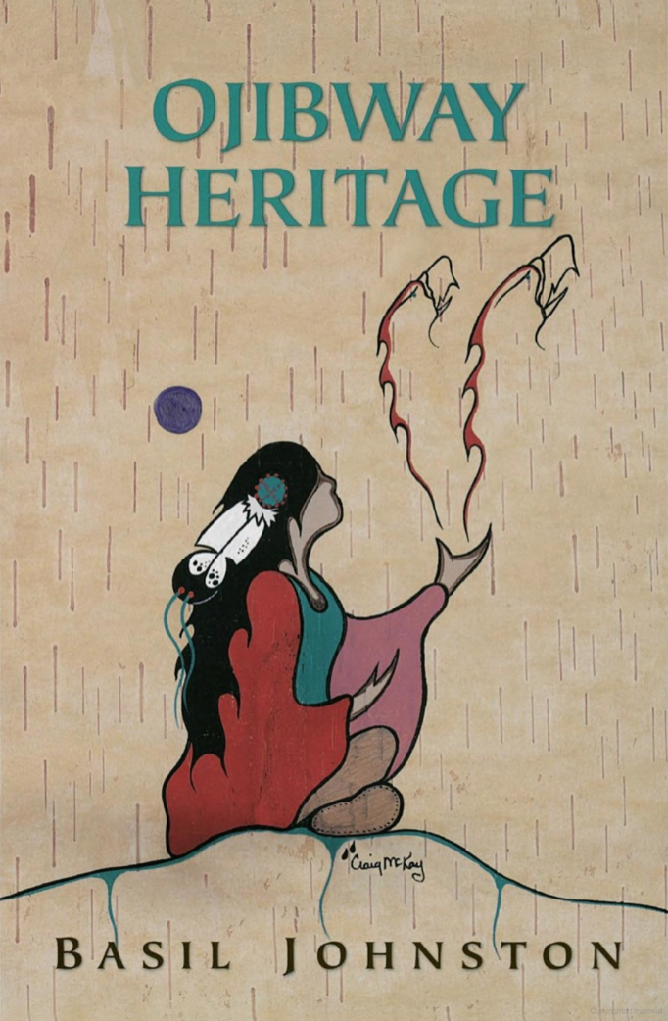
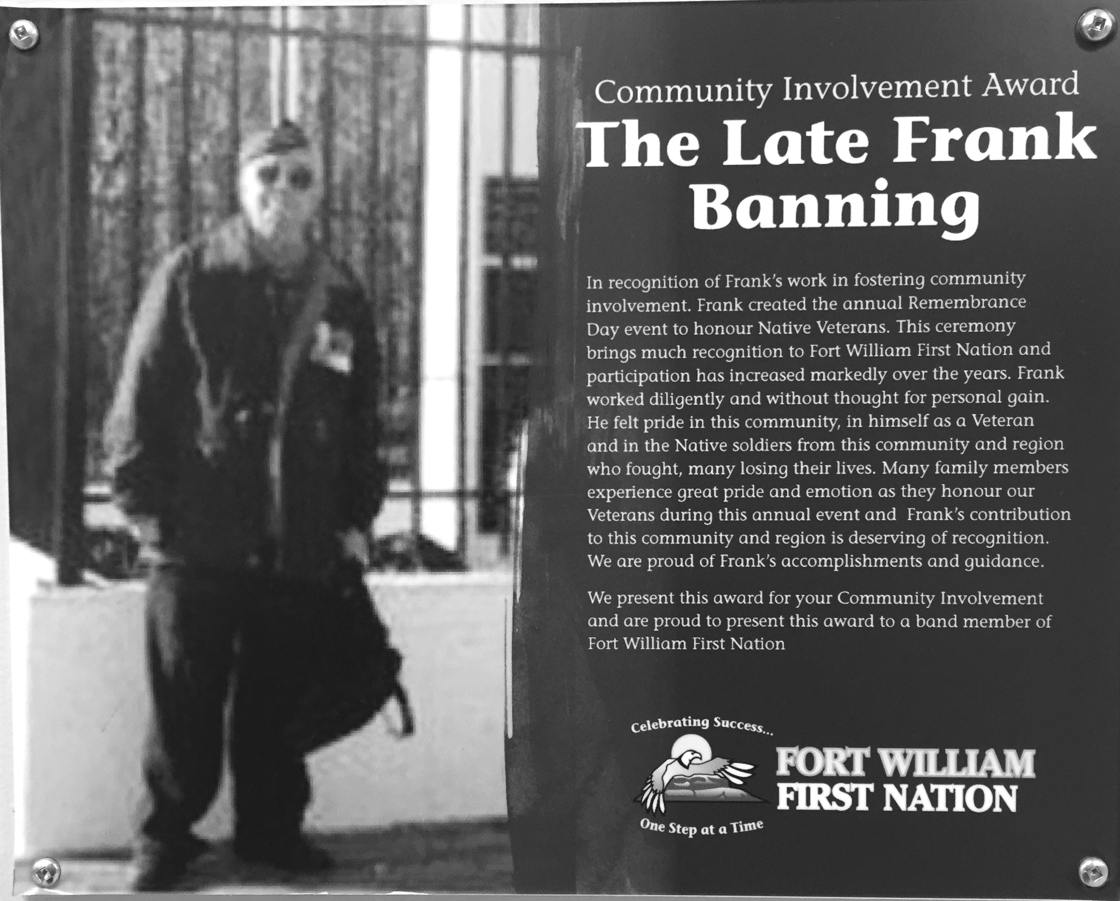
Adoption stories

Slide 10
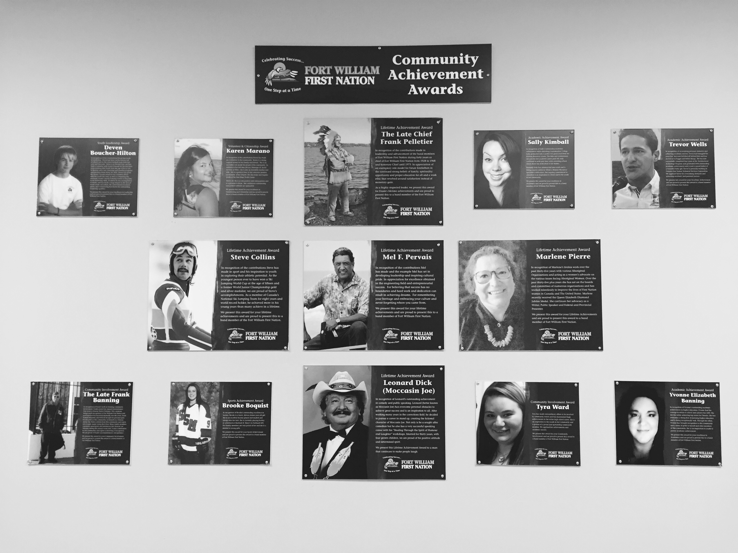

Adoption stories

Slide 11
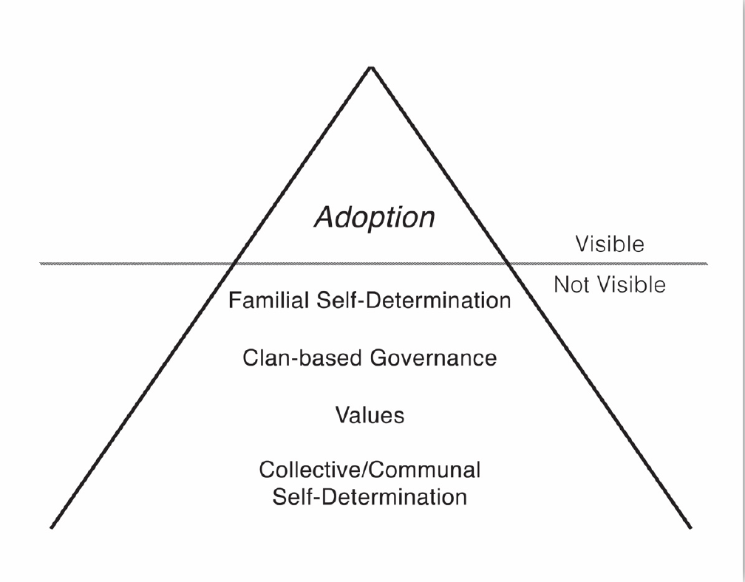
Adoption stories reveal a constitutional order
Damien Lee, “‘Because Our Law Is Our Law’: Considering Anishinaabe Citizenship Orders through Adoption Narratives at Fort William First Nation” (Unpublished dissertation, Winnipeg, University of Manitoba, 2017), 186, http://hdl.handle.net/1993/32277.

Slide 12
What does it mean?
Adoption stories, ceremonies, and language show us:
Citizenship is not a limited by biology – the principles are fluid and empowering
Citizenship is political self-determination, not just sexual self-determination.
Adoption is just one family-making practice. Others exist that we can look to.

Slide 13
Locating citizenship principles

Slide 14
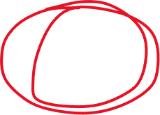
Citizenship
Adoption
Marriage
Birth
Kinship
Methodology

Slide 15
Citizenship
Born with status
Fought for status
Women
Men
Children
Elders
Rigorous because diverse

Slide 16
Citizenship
Born with status
Fought for status
Women
Men
Children
Elders
Knowledge of marriage
Knowledge of adoption
Birthing protocols
Two spirit
Parents of children w/o status
Transferees
Different nations
Racialized Nish (black, asian)
More Rigorous because
more diverse

Slide 17

Citizenship
Born with status
Fought for status
Women
Men
Children
Elders
Knowledge of marriage
Knowledge of adoption
Birthing protocols
Two spirit
Parents of children w/o status
Transferees
Different nations
Racialized Nish (black, asian)
More Rigorous because
more diverse

Slide 18
Citizenship through adoption lens:
Families assert political self-determination (not just sexual)
Caring for others, sharing with others = central
Race, blood, DNA, and Indian status replaced by self-determination
Therefore, no “flood gates” (saying yes = same power as saying no)
The family is the circle we draw around us:
  Citizenship is the same thing.

Slide 19
Miigwetch
Dr. Damien Lee
Toronto Metropolitan University
damien.lee@ryerson.ca
416-979-5000 x 556212

