Slide 1


GOVERNANCE AGREEMENT 101
Commissioner on Governance
Patrick Wedaseh Madahbee
E'Dbendaagzijig Citizenship Conference
April 28, 2022
Niigaan Zhaamin – Forward Together

Slide 2
“WE HAVE ALWAYS BEEN NATIONS”
Inherent Act/Sovereignty
Indian Act/Assimilation & Genocide
1763 Pontiac and the Great Ojibway War
1764 Treaty of Niagara
1800s Three Fires Confederacy, now Anishinabek Nation Grand Council
1920s League of Indian Nations of North America
1944 North American Indian Government Constitution – National Feast Day, June 5
1980 Anishinabek Nation Declaration *
Nationhood intact, Grand Council not recognized by Canada
1493 Papal Bull – Doctrine of Discovery and Terra Nullis
1800s Pre-Confederation Treaties
1800s Military balance of power shifts
1867 Confederation, BNA Act
1876 Indian Act – assimilation and genocide attack on language/knowledge and culture, including governance system
1982 Constitution Act recognizes Inherent, Aboriginal and Treaty Rights
2010 “rights recognition” era – new government to government relationship through negotiations
Niigaan Zhaamin – Forward Together

Slide 3
HISTORY OF SELF-GOVERNEMENT NEGOTIATIONS
Began in 1995 with Education and Governance negotiations and a commitment by Canada to engage in on-going sectoral negotiations.
Negotiating Recognition of Inherent Jurisdictions:
Anishinabek Education System. 23 First Nations operating the AES and remaining 17 now considering joining.
The Governance Agreement negotiations are now completed.
Our Koganaawsawin Child and Family Well-Being Law is now being implemented and under negotiation for recognition of inherent jurisdiction and fiscal transfers.
Health self-government negotiations are in development.
Niigaan Zhaamin – Forward Together

Slide 4
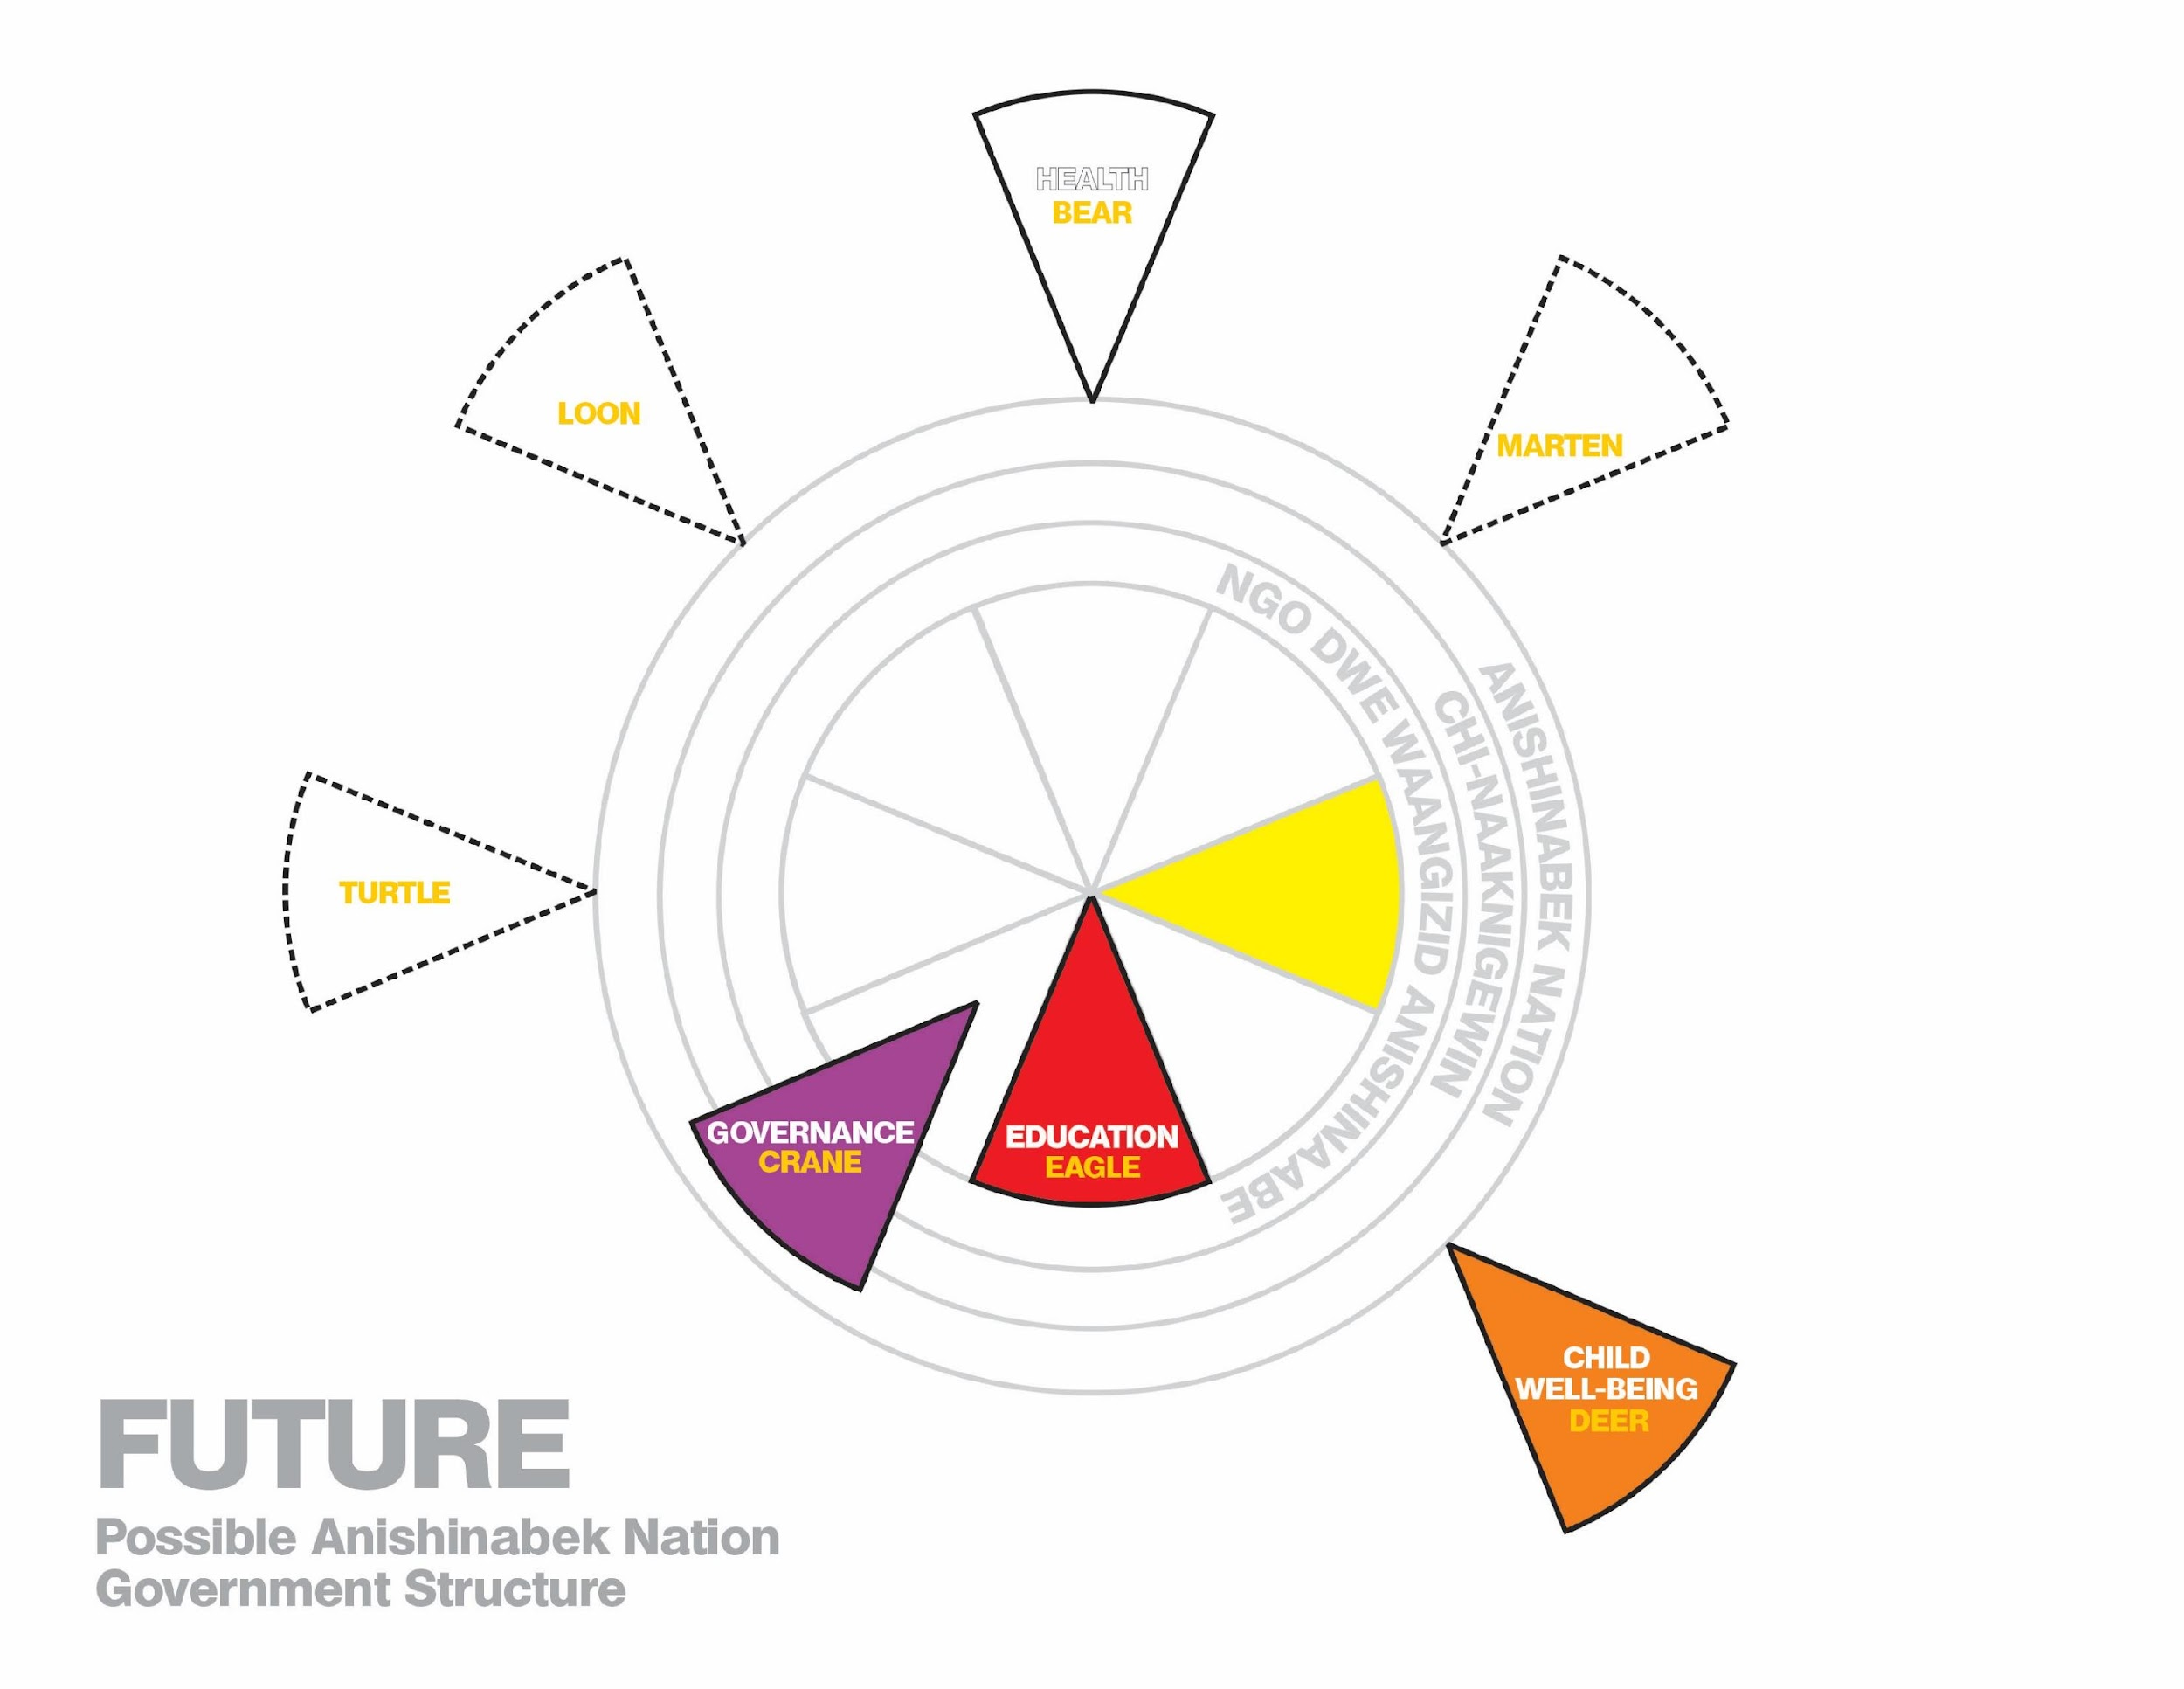
DODEMAAG GOVERNANCE SYSTEM RESPONSIBILITIES
Niigaan Zhaamin – Forward Together

Slide 5
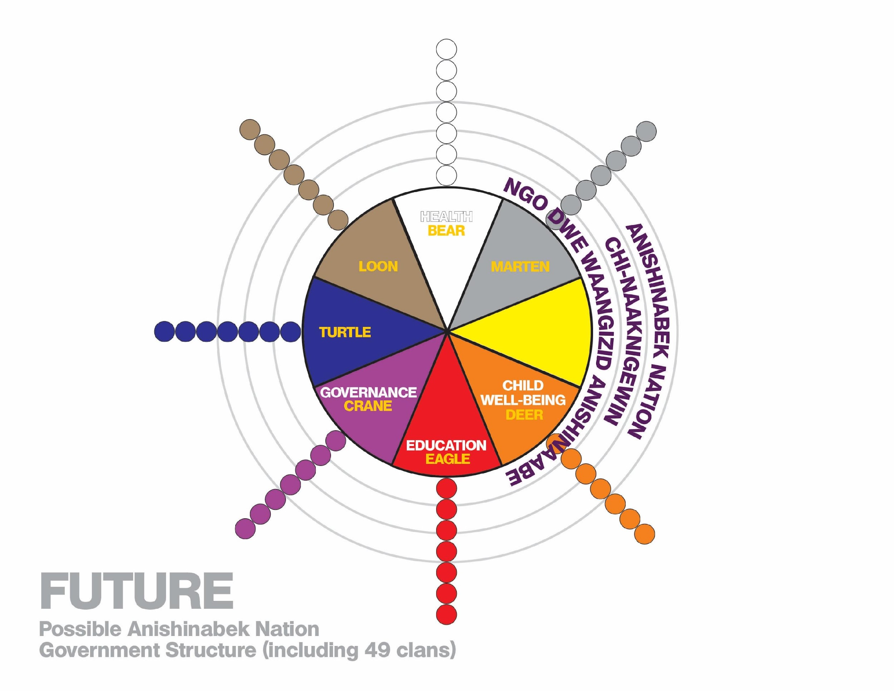
ANISHINABEK NATION GOVERNANCE
Niigaan Zhaamin – Forward Together

Slide 6
ANISHINAABE FOUNDATIONS OF GOVERNANCE
Governance is the process of governing: How we Govern.
Foundational to Anishinaabe Governance are:
  Language and Culture
  Determining E’Dbendaagzijig – Those Who Belong
  Anishinaabe Laws
  Families/Clans and communities working together today to honour and respect past and future generations
Anishinaabe Governance is the foundation to build our Anishinaabe future.
Niigaan Zhaamin – Forward Together

Slide 7
FOUR PILLARS OF GOVERNANCE
The Governance Agreement will recognize the foundation for our Anishinaabe future:
Identity – Language and Culture Laws
Belonging – Determination of E’Dbendaagzijig (citizenship)
Leadership Selection – How we select Leaders, Criteria, Indian Act system does not work in our family/kinship society. Roles and responsibilities of Leaders is to our Citizens not Indian Affairs.
Management and Government Operations – Citizens approve laws and policies = transparency, empowerment, trust.
Updated
March 9, 2022
Niigaan Zhaamin – Forward Together

Slide 8
ANISHINAABE GOVERNANCE BENEFITS
Recognition of Inherent Jurisdiction
Legal Status of the Governance Agreement
On-going Funding for Anishinaabe Governance
On-going Funding for a Central Body
Restoring Language, Culture and Identity
Decline Extinction of Status Indians
Indian Status to E’Dbendaagzijig
Nationhood
Niigaan Zhaamin – Forward Together

Slide 9
COMPLEMENTARY & COLLABORATIVE PROCESSES
Collectively, we have the same goals for our First Nations.
Governance is about how we govern: The principles and processes.
Governance supports First Nation law-making in all areas.
The Governance Agreement is an opportunity to evolve a First Nation’s governance practices and to have greater citizen involvement and ownership in decision-making and law-making.
This is an opportunity to strengthen Anishinaabe identity and pride through acquiring our language and culture, determining citizenship, and bringing people together.
A solid governance foundation assists how decisions are made, whether a First Nation is involved in land claims, legal actions, and other jurisdictional arrangements.
Niigaan Zhaamin – Forward Together

Slide 10
RESULTS OF THE GOVERNANCE NEGOTIATIONS
On April 6, 2022, Canada and Five Anishinabek Nation First Nations signed an historic Self-Government Agreement.
This marks an important step away from the Indian Act for the five signatory First Nations.
The ratifying First Nations will move forward to the enabling legislation process for Effective Date October 2022.
Niigaan Zhaamin – Forward Together

Slide 11
RATIFYING FIRST NATIONS
Moose Deer Point First Nation
Zhiibaahaasing First Nation
Magnetawan First Nation
Nipissing First Nation
Wahnapitae First Nation
Congratulations to the ratifying First Nations on all their hard work!
Outreach continues to the non ratifying First Nations to have an opportunity to run a vote on the Governance Agreement.
Niigaan Zhaamin – Forward Together

Slide 12
Miigwech
For more information on the Governance Agreement
Please Visit:
www.governancevote
Niigaan Zhaamin – Forward Together

