Slide 1
NISGA’A LISIMS GOVERNMENT

Slide 2
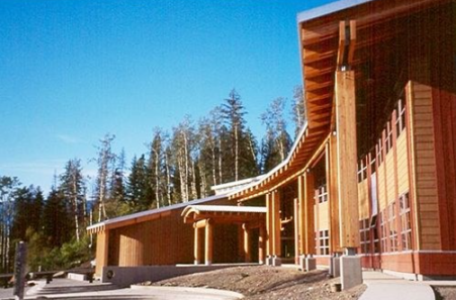
NISGA’A LISIMS GOVERNMENT
WWW.NISGAANATION.CA

Slide 3
NISGA’A LISIMS GOVERNMENT
WWW.NISGAANATION.CA

Slide 4
NISGA’A LISIMS GOVERNMENT
https://sway.office.com/OCbTWc2qMYtdiuVf?ref=Link
WWW.NISGAANATION.CA

Slide 5
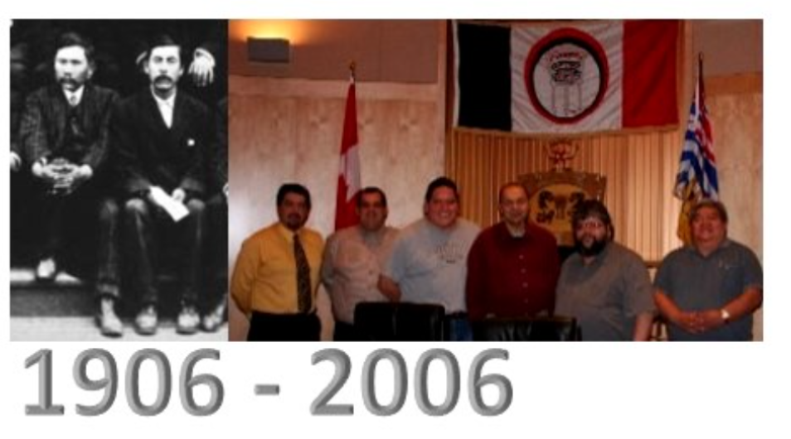
NISGA’A LISIMS GOVERNMENT
WWW.NISGAANATION.CA

Slide 6
NISGA’A LISIMS GOVERNMENT
WWW.NISGAANATION.CA

Slide 7
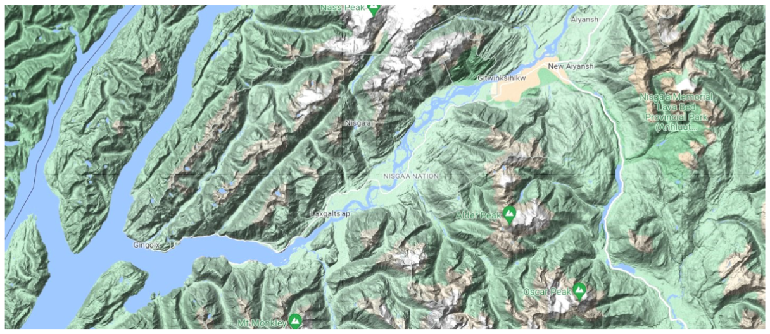
NISGA’A LISIMS GOVERNMENT
WWW.NISGAANATION.CA

Slide 8
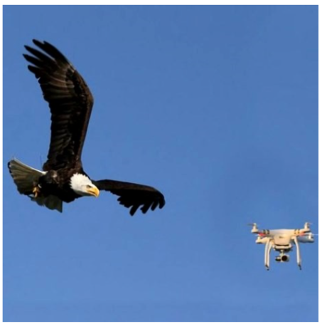
NISGA’A LISIMS GOVERNMENT
WWW.NISGAANATION.CA

Slide 9
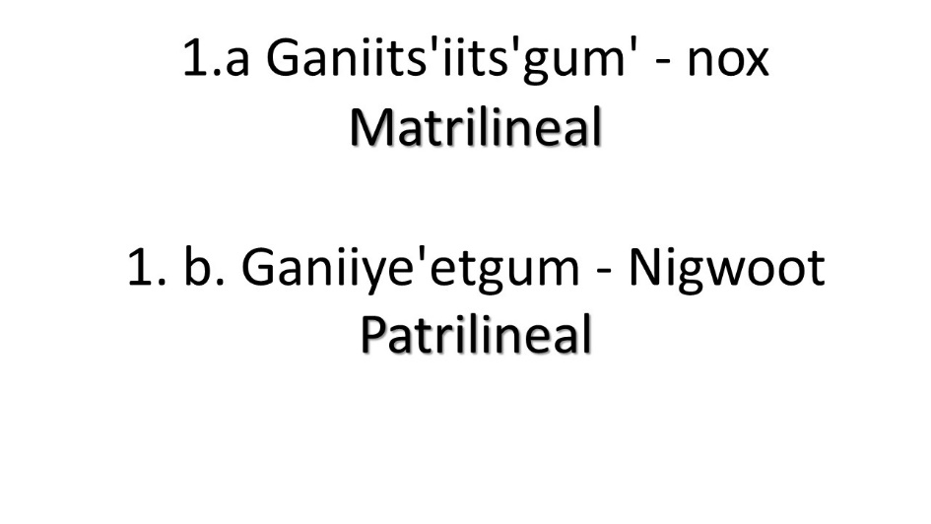
NISGA’A LISIMS GOVERNMENT
ELIGIBILITY CRITERIA
An individual is eligible to be enrolled under this Agreement if that individual is:
a. of Nisga’a ancestry and their mother was born into one of the Nisga’a tribes;
b. a descendant of an individual described in subparagraphs 1 (a) or 1 (c);
c. an adopted child of an individual described in subparagraphs 1 (a) or 1 (b); or
d. an aboriginal individual who is married to someone described in subparagraphs 1 (a), (b), or (c) and has been adopted by one of the four Nisga’a tribes in accordance with Ayuukhl Nisga’a, that is, the individual has been accepted by a Nisga’a tribe, as a member of that tribe, in the presence of witnesses from the other Nisga’a tribes at a settlement or stone moving feast.
WWW.NISGAANATION.CA

Slide 10
NISGA’A LISIMS GOVERNMENT
WWW.NISGAANATION.CA

Slide 11
NISGA’A LISIMS GOVERNMENT
ELIGIBILITY CRITERIA
An individual is eligible to be enrolled under this Agreement if that individual is:
a. of Nisga’a ancestry and their mother was born into one of the Nisga’a tribes;
WWW.NISGAANATION.CA

Slide 12
NISGA’A LISIMS GOVERNMENT
ELIGIBILITY CRITERIA
An individual is eligible to be enrolled under this Agreement if that individual is:
a. of Nisga’a ancestry and their mother was born into one of the Nisga’a tribes;
b. a descendant of an individual described in subparagraphs 1 (a) or 1 (c);
c. an adopted child of an individual described in subparagraphs 1 (a) or 1 (b); or
WWW.NISGAANATION.CA

Slide 13
NISGA’A LISIMS GOVERNMENT
ELIGIBILITY CRITERIA
c. an adopted child of an individual described in subparagraphs 1 (a) or 1 (b); or
WWW.NISGAANATION.CA

Slide 14
NISGA’A LISIMS GOVERNMENT
ELIGIBILITY CRITERIA
d. an aboriginal individual who is married to someone described in subparagraphs 1 (a), (b), or (c) and has been adopted by one of the four Nisga’a tribes in accordance with Ayuukhl Nisga’a, that is, the individual has been accepted by a Nisga’a tribe, as a member of that tribe, in the presence of witnesses from the other Nisga’a tribes at a settlement or stone moving feast.
WWW.NISGAANATION.CA

Slide 15
NISGA’A LISIMS GOVERNMENT
Aboriginal (section 35(2) of the Constitution Act of 1982)
Legally married provide a marriage certificate
Adopted by a Nisga'a tribe and has been accepted by a Nisga'a tribe
Name 1 witness from each tribe during custom adoption at a settlement or stone moving feast
Long-form birth certificate
WWW.NISGAANATION.CA

Slide 16
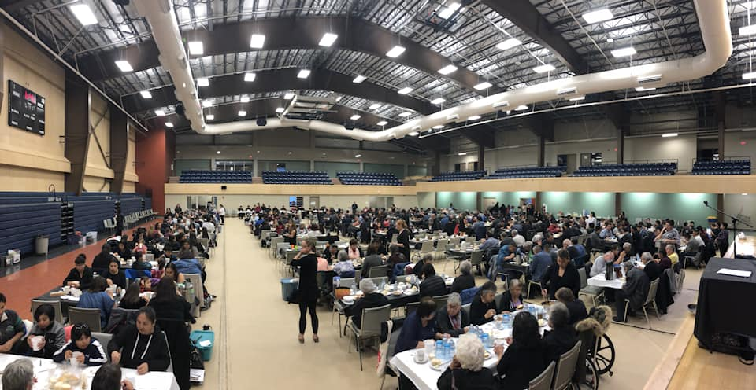
NISGA’A LISIMS GOVERNMENT
WWW.NISGAANATION.CA

Slide 17
NISGA’A LISIMS GOVERNMENT
WWW.NISGAANATION.CA

Slide 18
NISGA’A LISIMS GOVERNMENT
Nisga'a Indian Benefits resident on Nisga'a Lands
Health Programs (if resident on Nisga'a Lands);
Community Healing Programs, including traditional healing practices
Public health services, including health promotion and illness prevention, home & community care services
Social programs (if resident on Nisga'a Lands)
Child and family services to Indian child (if parent is ordinarily resident on Nisga'a Lands)
Training, education and employment programs, or other measures, to reduce reliance on income assistance
Education programs (if resident on Nisga'a Lands)
Nisga'a Language and Nisga'a culture programs
Nursery school programs and services
Instructional services for students attending Kindergarten to Grade 12
Instructional support services for students attending K - Grade 12
Special education and ancillary services for students attending K - Grade 12
Nisga'a Indian Benefits resident off Nisga'a Lands
MSP premiums (phased out January 1, 2020)
Non-Insured Health Benefits
Financial Support for the delivery of post-secondary education and training programs
Financial support to attend accredited post-secondary education and training Institutions
WWW.NISGAANATION.CA

Slide 19
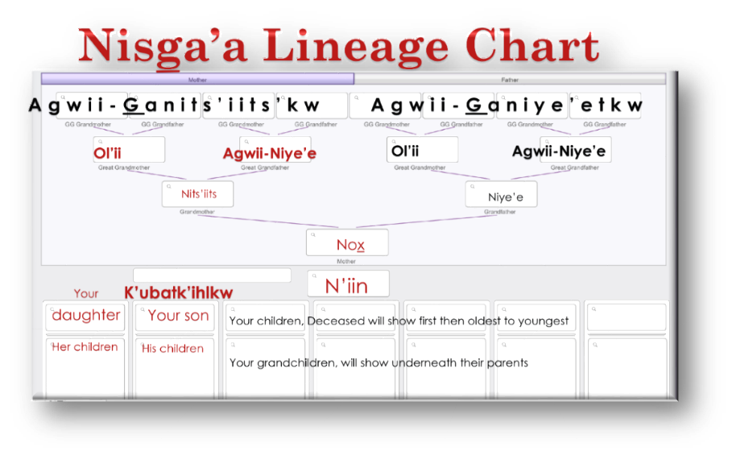
NISGA’A LISIMS GOVERNMENT
WWW.NISGAANATION.CA

Slide 20
NISGA’A LISIMS GOVERNMENT
The new beginning of Citizenship law, Wil sii sit’aatkwst,
is dedicated to our ancestors
who guide & sustain us to this day,
to all who support our efforts to secure our heritage &
to the Nisga’a children, who are our future.
WWW.NISGAANATION.CA

