Slide 1
Anishinaabemowin: Successes of building language and culture.
Dominic Beaudry

Slide 2
Mnjikaning Giigoonhkaan: Mnjikaning Fish Weirs a national historic site built 2500 BC near Orillia, ON

Slide 3
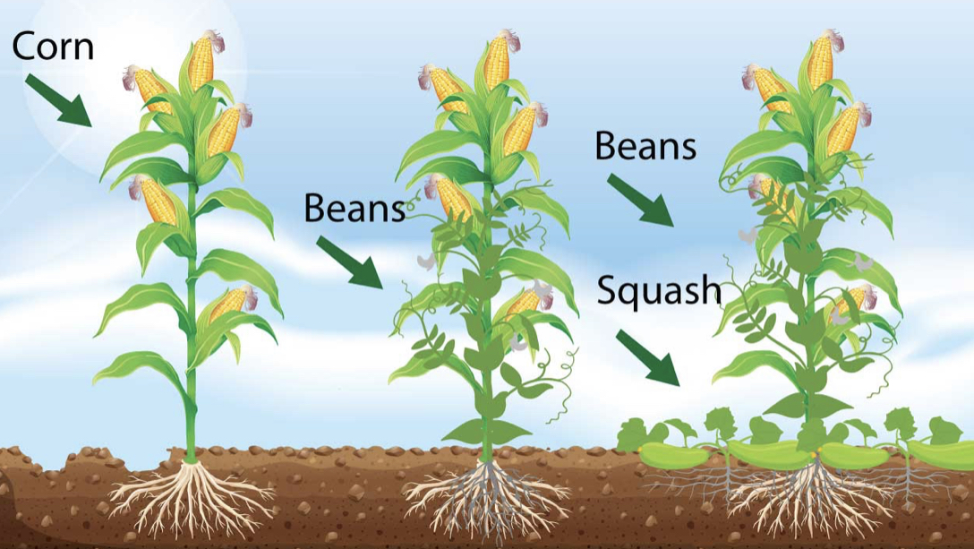
Gitiganan: Gii gitigewag Anishinaabek.
Mandamin, miskodiismin miinwaa koosmaan.
Anishinaabe names for agriculture- mandamin, Pinconning, garden river, garden village and Gitikaan Ziibiing.

Slide 4
Anishinaabe Community during contact period at Secotan near North Carolina. Art from Thomas Harriet’s ‘A Briefe And True Report Of The New Found Land Of Virginia, 1588.

Slide 5
Ziisbaakwatakaan.

Slide 6
Waabikike- Pottery Maker

Slide 7
Odawayii- Trade. Indigenous agricultural science transforms the word.

Slide 8
Tikonaagan- Cradleboard. Ojibwe Inventor Olivia Poole and Jolly Jumper

Slide 9
Biiwaabiko Nimoosh- Rover Aaron Yazzie, Navajo NASA.

Slide 10
Understanding our historical narratives is critical.
Students need to learn their history while learning their language.
Culture, language and history creates connections from the past to the present.
Miigwech follow me: at Twitter, Facebook and Instagram or on my Youtube Channel.

