Slide 1


Anishinabek Culture & Language Laws
Where Do We Start as a First Nation?
Fred Bellefeuille

Slide 2

Introduction
The Anishinabek Nation Governance Agreement (ANGA) recognizes law-making in regards to Culture and Language.
The governance agreement includes a fiscal agreement which includes funding to support governance under the ANGA. This includes culture and language.
“We must immerse ourselves in the language if we are to learn it.” Barbara Nolan
What does “immerse ourselves” mean?
Culture & Language
Niigaan Zhaamin – Forward Together

Slide 3
What Does Law-making Power
Over Culture & Language Mean?
The band office cannot do it all.
It means that the First Nation can force, by power of law, third parties to support nation goals in regards to culture and language.
Who are the third parties?
Generally the band office that implements strategies however, this enable others including:
  Other governments (Federal and Provincial) who do business on the reserve.
  Non-member businesses that are on reserve or enter onto the reserve to do business.
  Band member businesses that operate on reserve or enter onto the reserve to operate.
  Utilities and other services to the reserve.
  Others.
Culture & Language
Niigaan Zhaamin – Forward Together

Slide 4
If you don’t even ask,
you won’t get it for sure.
Culture & Language
Brigitte van Tuijl
Niigaan Zhaamin – Forward Together

Slide 5








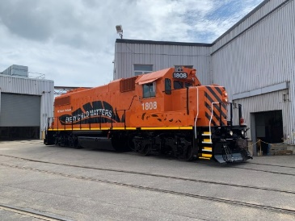
Culture & Language
Niigaan Zhaamin – Forward Together

Slide 6
What Other Nations Do With
Their Law-making Power Over Culture & Language
Sweden, Norway, Finland, all have laws to promote the use of the Sami Language.
New Zealand: Māori Language Act.
Scotland: Gaelic Languages Act.
Ireland: Official Languages Act.
Italy: Linguistic Minorities Law.
Taiwan: Indigenous Peoples Basic Law.
Culture & Language
Niigaan Zhaamin – Forward Together

Slide 7
What Other Nations Do With
Their Law-making Power Over Culture & Language
Each law has the force of law – means without their agreement.
Each establishes their language as an official language.
Each has the provisions of services in the official language.
Some have the creation of a plan to revitalize the language.
Some establishes a board or body to implement a plan.
Some have a resource person (Commissioner) for support and oversight for law.
Culture & Language
Niigaan Zhaamin – Forward Together

Slide 8
What Other Nations Do With
Their Law-making Power Over Culture & Language
Some have law sections in their law related to education, communication, radio, press and TV public service.
Some authorize the creation of policies, procedures, measures, and practices designed to give effect to the use of the language.
Some signage for government and public facilities in aboriginal areas must feature indigenous languages, including mountains, monuments and streets in such regions should they feature traditional indigenous names.
Compiling teaching materials, cultivating educational personnel and promoting academic research. State-run indigenous media outlets are also required to produce programs and publications for promoting and teaching indigenous languages, according to the act.
Culture & Language
Niigaan Zhaamin – Forward Together

Slide 9
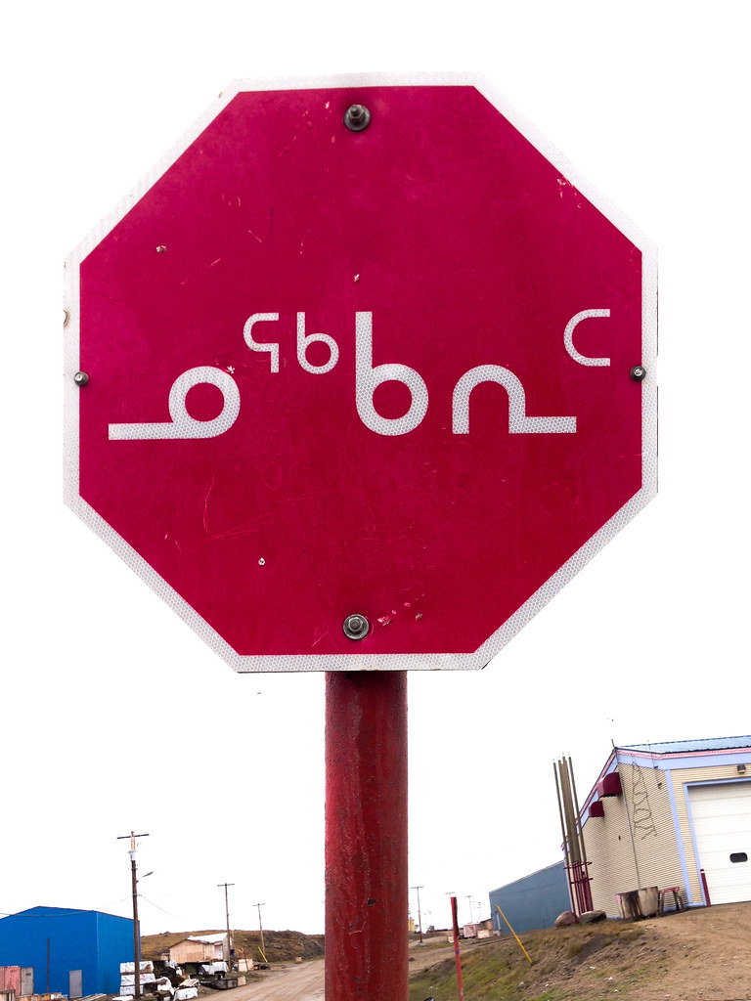
Language Laws in Canada
Nunavut Official Languages Act – Gives language official status, supports use of indigenous language for government services, duty to provide service.
Inuit Language Protections Act – Creates Inuit language authority, mandates language standards, requires all municipalities to provide service in Inuit language.
Culture & Language
80-90
60-80
Niigaan Zhaamin – Forward Together

Slide 10
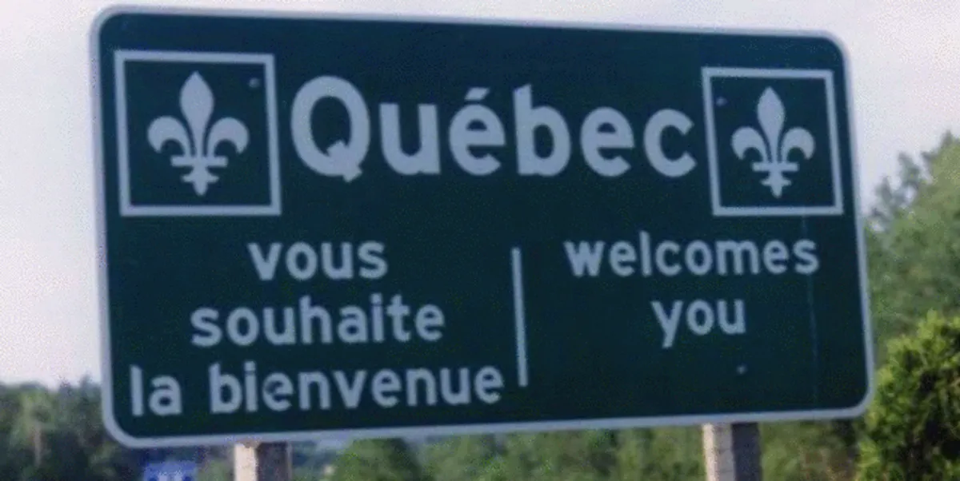
Bill-96 Promotes Use of French Language in Quebec
Must provide service to customers in French.
Must do job postings in French.
Must include French in signage related to commercial publicity.
Products produced must be in French.
Service contracts with government must be in French and have French requirements.
Culture & Language
Niigaan Zhaamin – Forward Together

Slide 11
Where Do We Start to Create
a First Nation Law?
Does your First Nation have a plan in regards to culture and/or language?
Does you First Nation have a strategic plan?
Does the strategic plan include culture and/or language?
If no, can you glean culture and language strategic objectives from their education, health, economic development priorities?
What are the strategic goals and objectives?
Can any of those goals and objects be done by third parties?
Culture & Language
Niigaan Zhaamin – Forward Together

Slide 12
Possible Strategic Objectives to Mobilize in the Law
Culture & Language
Niigaan Zhaamin – Forward Together

Slide 13
Have More Federal/Provincial
Programs Promote
Anishinaabemowin
All agreements with these agencies require compliance with local, federal and provincial laws. Eg employment standards
Consider language requirement to essentially force the federal and provincial government to finance professional development for First Nation service.
Consider requirement to have information and literature including language and cultural elements.
Consider creation of culture and language standard certification for governments.
Culture & Language
Niigaan Zhaamin – Forward Together

Slide 14
Have First Nation Businesses
Promote Anishinaabemowin
Consider requirement for business signage to include Anishinaabemowin and culture.
Support – Grant for conversion of signage, translation resource people.
Consider language requirement for service delivery for businesses such as greetings requirement in Anishinaabemowin.
Support – Training sessions and grants for participation.
Consider online business conversion requirement to have more Anishinaabemowin.
Support – Grants and translation support
Creation of culture and language standard certification.
Culture & Language
Niigaan Zhaamin – Forward Together

Slide 15



Non-First Nation business Indigenous Friendly Standard Certification
Consumer demand for such things as eco-friendly, non-toxic, and sustainably-sourced products continues to rise, so does the use of certifications on packaging
Creation of Indigenous culture and language standard certification.
Standards are created and companies are granted permission to use the logo
Culture & Language
Niigaan Zhaamin – Forward Together

Slide 16
Other Possible Strategic
Objectives
Have non-member businesses doing business on reserve support culture and language.
What can non-member businesses do?
Have big utilities, other services support culture and language.
What can utilities and other services on reserve do?
Others.
Culture & Language
Niigaan Zhaamin – Forward Together

Slide 17
Culture & Language Law Implementation Plan
A culture and language law will not be successful without a budget and plan to utilitize the budget.
Resources have been provided under the governance agreement.
Each and every strategic objective must have a plan to implement.
Someone must manage the plan.
Culture & Language
Niigaan Zhaamin – Forward Together

Slide 18
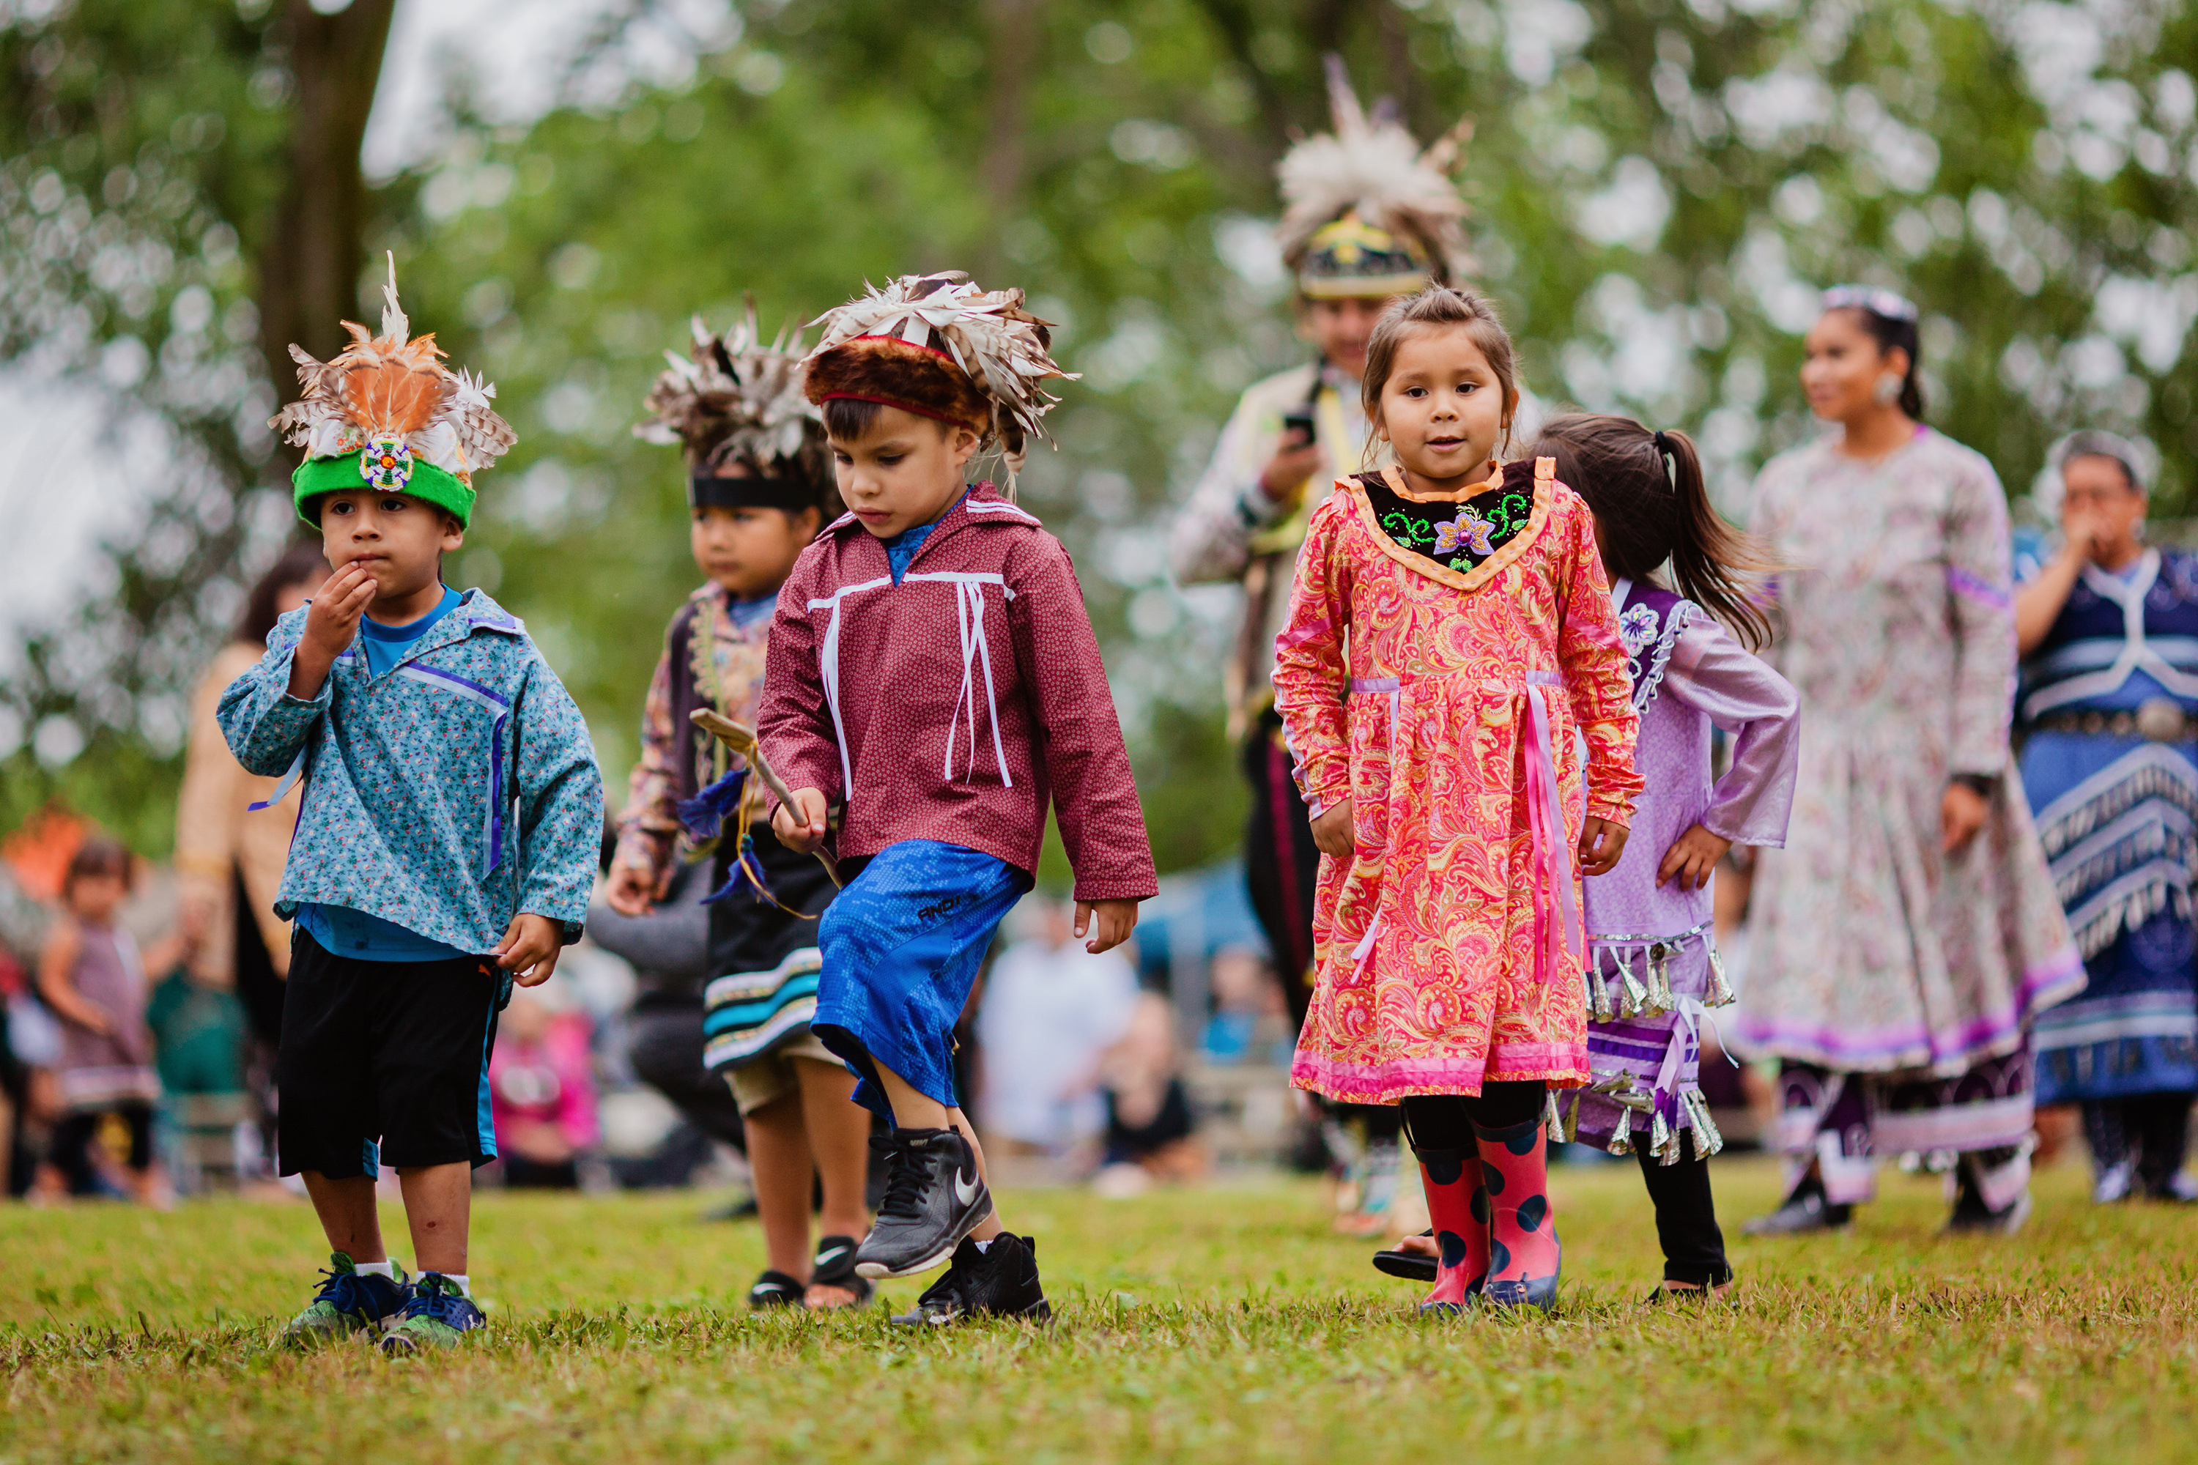
Miigwetch
Niigaan Zhaamin – Forward Together

